Slide 1


Real-time emotion recognition in virtual reality
Jeremy Di Dio
Sruti Bhattacharjee
Semester Project Fall 2021

Slide 2
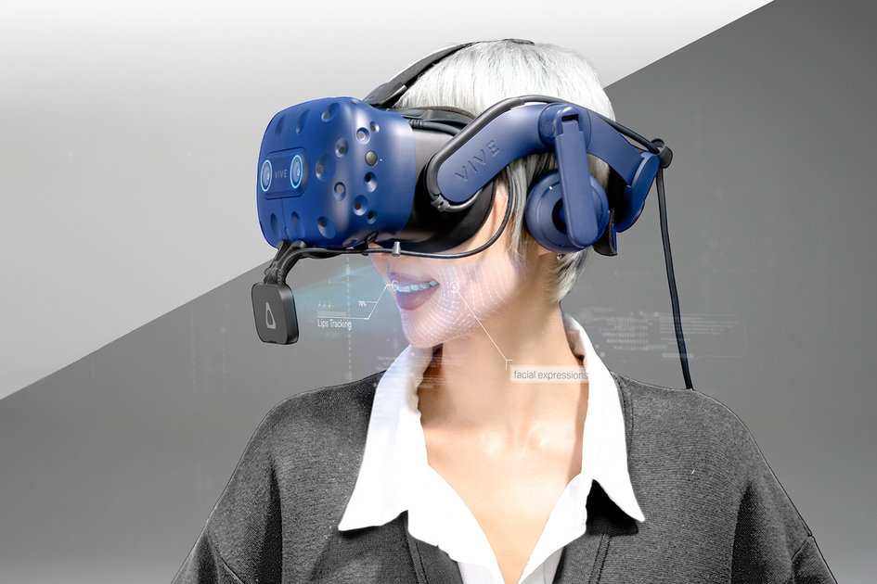
Outline
Project Description
Project Road Map
Database Creation
Models Implementation
Evaluation
Future work
Conclusion
Notes:
We will firstly describe the project, the timeline and where we currently are. Then we will describe some technical part of what we are actually working on.

Slide 3
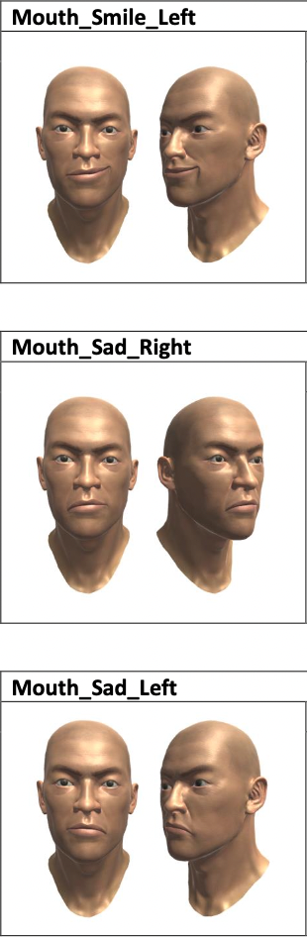
Project Description
New HTC Vive facial tracker
Blendshapes data
Identification of 6+1 basic emotions
Happiness, Fear, Anger, Surprise, Disgust, Sadness
Neutral
Real-time emotion recognition
Notes:
The goal of this project is to use the new HTC vive facial tracker combined with the Vive pro eye which provides us what we call “blendshape”, a set of value that is used to mirror the subject expression on an avatar face. We have in total 52 blendshapes value (38 lips + 14 eyes)
It is then based on theses blendshape values that we will develop a ML model for emotion recognition. It will be able to recognise the 6 basic emotions (Happiness, Fear, Anger, Surprise, Disgust and Sadness) as well as a neutral expression.
As emotion recognition is already really advance in computer vision domain, the main motivations here is to use this new type of data to evaluate emotion.
To summarize, the main goal of this project is to use only these new features (blendshapes) to build a real-time emotion recognition suitable for VR usage.

Slide 4
Project Road Map
AUs - Blendshapes mapping
Database creation
Emotion recognition models
Models evaluation
Week 1 to 6
Week 6 to 13
Week 10 to 13
Week 13 to 14
Notes:
The project was composed of 3 main parts :
Creation of a usable dataset
Creation of a ML model able to recognize emotion based on the dataset created
Finally, evaluate the model performance in real-time

Slide 5


Database Creation
Extended Cohn-Kanade database (CK+)
Facial Action Coding System
Collected expressions
6 Basic emotions
16 relevant AUs
AU 9
AU 12
Farnsworth, B. (2019, August 18). Facial Action Coding System (FACS) – A Visual Guidebook. Imotions. Retrieved October 1, 2021, from https://imotions.com/blog/facial-action-coding-system/
Notes:
CK+ : This is the dataset on which we have chosen to base ourselves. It uses posed expression of the 6 basic emotions and is totally FACS coded. We chose it because it is the most used dataset in term of emotion recognition and is the most suitable for our project.
FACS : Useful coding system for emotion recognition. It decomposes facial expression into Action Units which represent each a single expression (see right image). It also have a well-known mapping from AUs directly to emotion.
Data
Based on this, we choose to record 2 types of expression :
First, 16 selected single action unit which are relevant for emotion recognition
Combination of action unit (represented as the 6 basic emotions)

Slide 6
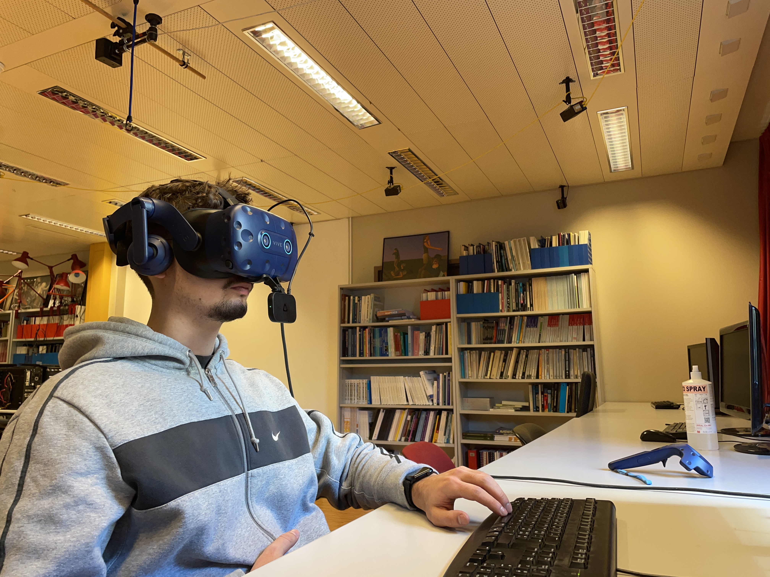
Recording Protocol
Expression explanation
Repeated 22 times
Recording
5s
Preparation
5s
Participant being recorded
Recording process
Notes:
So in the application,
Subject will be asked to do a certain expression (AU or emotion)
Subject will see the corresponding expression on a pane on the left side
When subject is ready, experimenter press button and a countdown is shown indicating the recording will start (5 second countdown)
Recording starts, Subject will perform the requested expression going from neutral to apex to neutral for a duration of 5 second
A counter (5 second) will be shown to help subject manage time
Subject will have to press trigger on controller to indicate he has reach his apex expression
Recording stop, experimenter go to next expression and restart the process
The recorded data are the following :
Blendshape value (at a frequency of 20Hz but may vary)
Raw video of lips

Slide 7
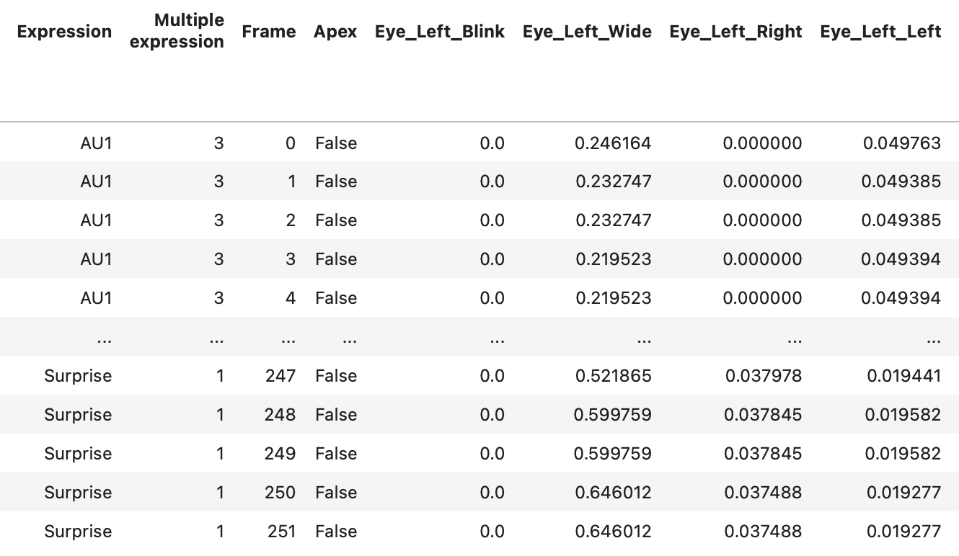
Collected Data
Blendshapes
Raw lips video
Notes:
Lips video sample later in the presentation
So in the application,
Subject will be asked to do a certain expression (AU or emotion)
Subject will see the corresponding expression on a pane on the left side
When subject is ready, experimenter press button and a countdown is shown indicating the recording will start (5 second countdown)
Recording starts, Subject will perform the requested expression going from neutral to apex to neutral for a duration of 5 second
A counter (5 second) will be shown to help subject manage time
Subject will have to press trigger on controller to indicate he has reach his apex expression
Recording stop, experimenter go to next expression and restart the process
The recorded data are the following :
Blendshape value (at a frequency of 20Hz but may vary)
Raw video of lips

Slide 8
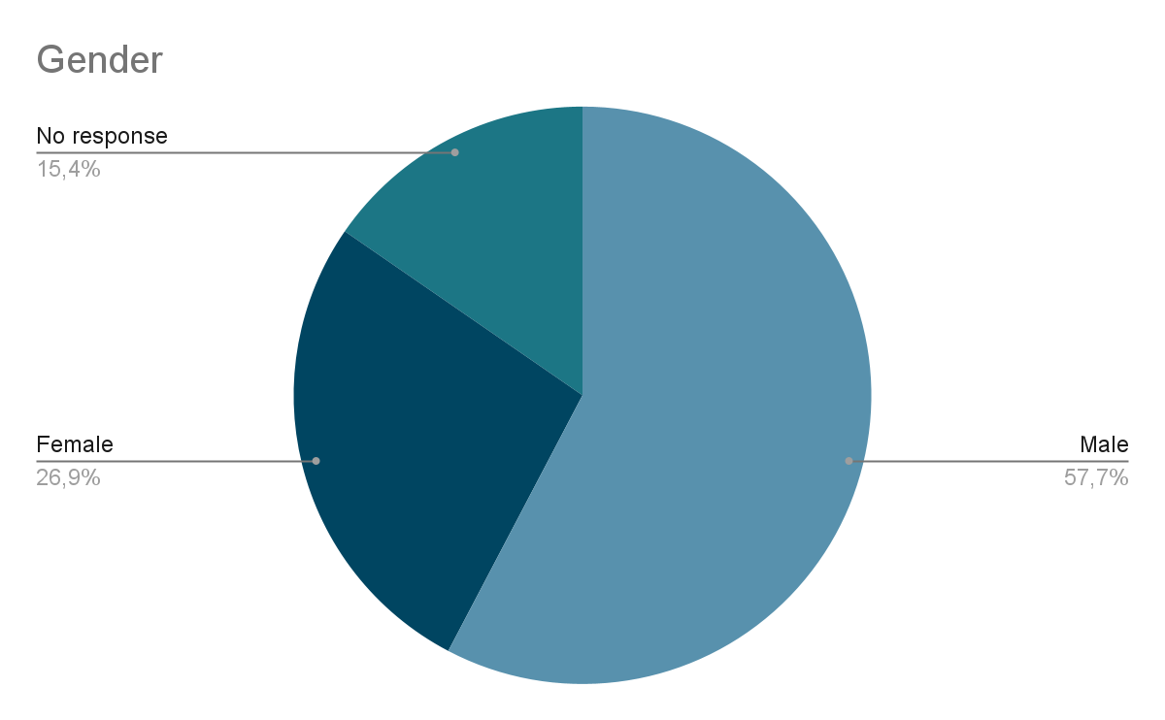
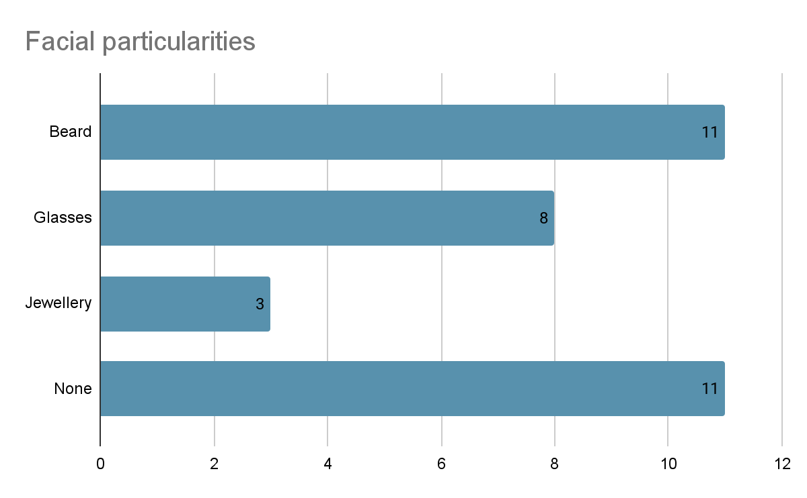
Participants Details
Total of 27 participants
Average age of 26
Estimation of 5’500 samples by participants

Slide 9
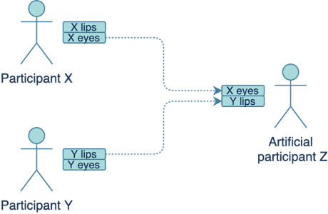
Models Implementation
Dataset preparation
Remove inconsistent data (one participant removed)
Selection of relevant samples (210 samples per participant)
Data augmentation to a total of ~15’000 samples
Random Forest and LightGBM
By participant cross-validation
10 round of randomized 80/20 split of training and testing set
Data augmentation illustration
Notes:
Before starting implementing the models, we had to prepare the dataset.
We first removed inconsistent data like multiple recording of the same expression.
We also had to remove one participant due to problem during the recording, so we got 26 participant in total.
Then we selected relevant subset of samples. As the goal was to recognize emotion directly, we discarded AUs labeled samples.
Finally, we proceeded to a data augmentation. We used the fact that Eyes and Lips data were in two different files to create synthetic participant by taking at random the lips data from one participant and the eyes data of another participant. The figure on the right illustrates this process.
We thus have been able to double our dataset to 52 participants and around 15'000 samples.
We also had to select which model were most suitable for our dataset and based on the restricted size of it and the fact that we had labelized data, we selected Random forest and LightGBM.
They are both using a collection of decision tree to output a prediction, but they differ in the way they are building the trees.
Finally, to be able to have a meaningful insight of the accuracy and to improve our models, we have built our own by participant cross-validation method. This means that the accuracy was computed as follows:
First, we randomly select 10 participant and set them as the test set and the rest as training set.
Then we trained the model on the training set and evaluated the accuracy using the testing set to have a first accuracy. We repeated this process 10 other times to have 10 different accuracy and we computed the real accuracy as the mean of all these accuracies

Slide 10
Random Forest and LightGBM
Library used
Scikit-learn
Lightgbm
Hyperparameters tuned
Maximum depth, Number of trees
Number of trees, Learning rate, Number of leaves
Accuracies achieved
/ | Random Forest | LightGBM
Accuracy with D.A | 48% | 52%
Accuracy without D.A | 37% | 38%
Notes:
To build the two different models, we used the scikit-learn python library and the lightgbm library, they helped us to easily implement, train and evaluate the models.
The main work we had to do was thus to tune the hyperparameters, for the random forest the hyperparameters tuned were the maximum depth and number of trees.
And for the lightgbm model, the hyperparameter tuned were the number of trees, the learning rate and the number of leaves.
We tuned only these hyperparameters because they were the one that were really impacting the performances of our models.
Regarding the final accuracies achieved, as shown on the table on the right, we achieved 48% accuracy for the random forest classifier and 52% for the Lightgbm model.
We can also see that the data augmentation we have done, helped us to increase significantly the accuracy for both models

Slide 11
Evaluation
Offline evaluation
posed and unposed emotion recording
Unity integration complexity
Real-time evaluation simulation
The goal is to simulate a real-time prediction on pre-recorded data
Evaluation visualization web application
We build a webapp to visualize and simulate real-time evaluation
Notes:
Once we were done implementing and training the two models. We proceeded to the evaluation part.
Our first idea of evaluation was to build a VR application with the emotion predicted in real-time. Unfortunately, due to time constraints and the complexity of the work required, we opted for another type of evaluation. An offline evaluation
This means that instead of predicting emotion on real-time data, we first collected data and then we evaluated our models on it.
So, the goal of this offline evaluation, was to simulate a real-time evaluation on pre-recorded data.
Finally, when the data were collected, we built a small web application to help us visualize our model’s performance and create a real-time evaluation simulation.
To save time for this presentation, we duplicate all our results from the web app in the following slides.

Slide 12
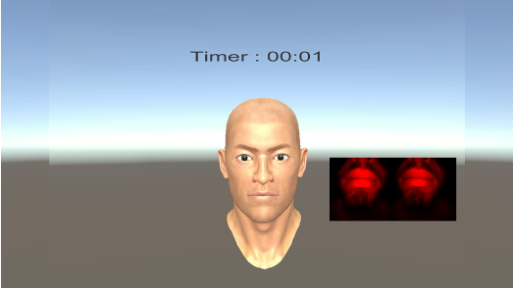
Evaluation Set
Same recording app as for training dataset
Two continuous recording of the 6 basic emotions
Predefined order VS undefined order
Two 25 seconds recording
2 participants in total
Both Male, both little beard, one with eyeglasses
Screenshot of participant’s view
Notes:
To respect our method of evaluation, the first thing we had to do was to collect real data.
For this, we used the exact same protocol as for the database creation, same application, same command (apex indication) and same collected data (blendshape values and screen video).
The only difference this time, was that participants were not asked to performed 22 different recording for all the expressions, but instead to perform the 6 basic emotions + the neutral state in a single recording of 25 seconds.
Each participant had to repeat this process twice, first with a predefined emotion order and second in the order they wanted.
In total, we have been able to record 2 participants, they were both male, with little beard and one of them were wearing eyeglasses.

Slide 13
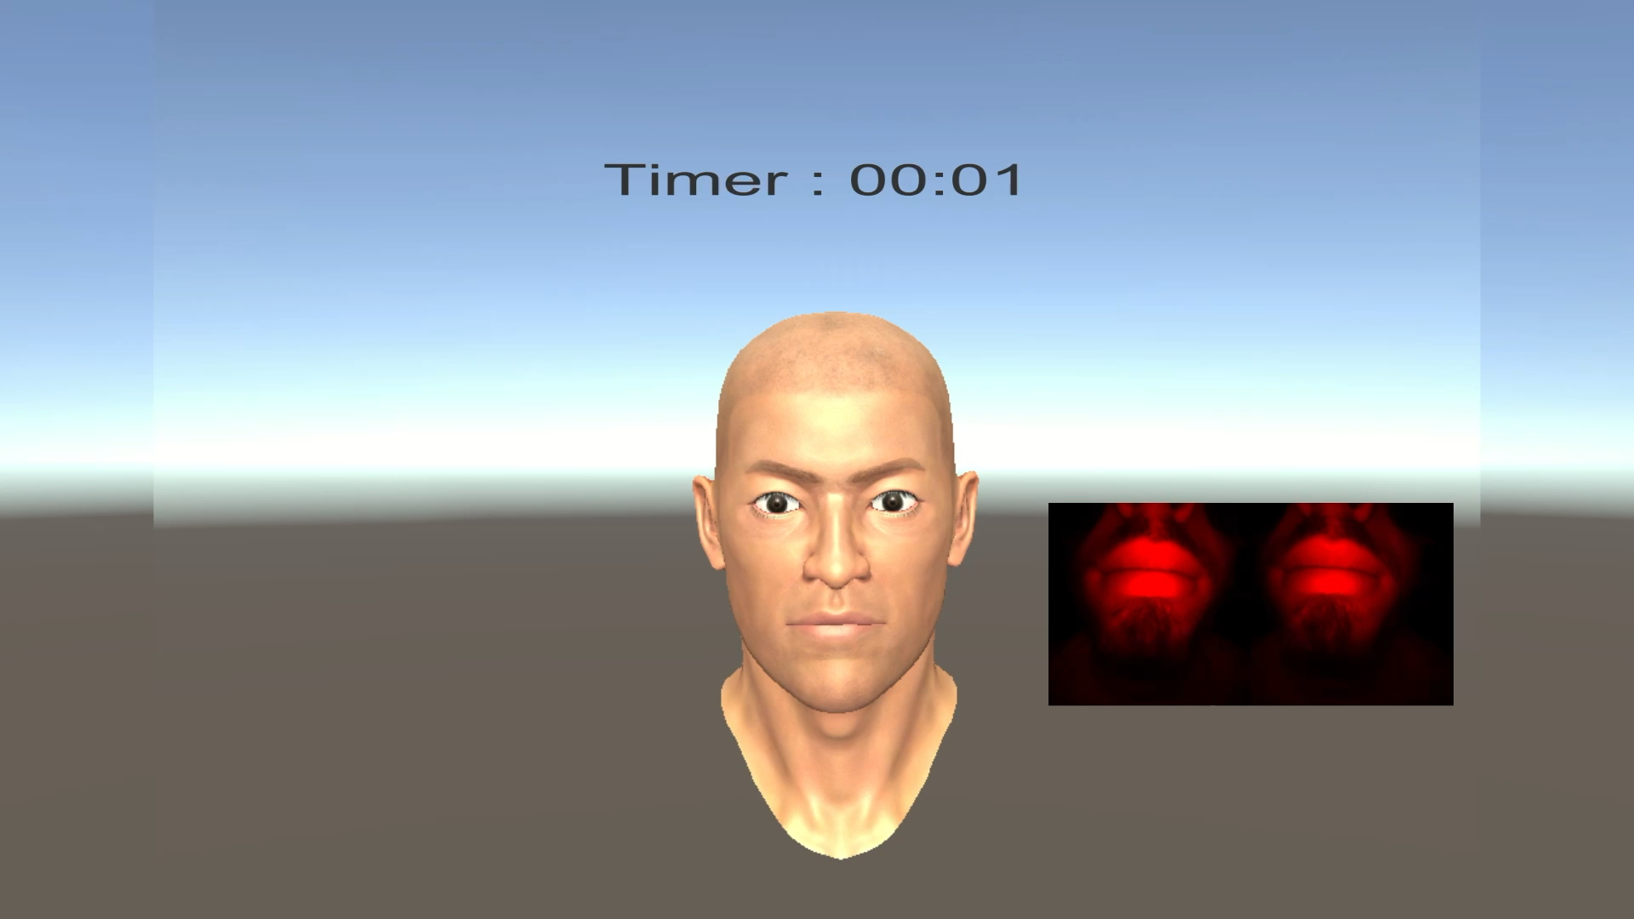
Real-Time Simulation
Live prediction simulation
Based on pre recorded data
Probability view
Each emotion is predicted by a percentage of certainty
Final visualization
Emotions’ order: neutral, happy, sad, fear, angry, surprise, disgust
Notes:
Once the data were collected, we proceeded to the real-time simulation.
For this, we ran our models on the collected samples and we created a video of these predictions that match the recorded video of the participant.
The prediction we outputted was in term of probability. Instead of predicting only a single emotion, each emotion were attributed a percentage of activation.
For you to better understand how this evaluation works, I will now show you the recorded video of one participant with the corresponding predicted emotion. The model used here is the LightGBM one.
You will see the timer in red, indicating that it is currently recording, and on the left the prediction corresponding to the video.
As you can see, the prediction is working well for the peak point of each emotion, but it is noisy in between the emotions, this can be explained by the fact that our model don’t know how to manage transition data, which is not particular to any emotion.

Slide 14
Results
Emotions | Random Forest | LightGBM
Anger | 55% | 62%
Disgust | 62% | 61%
Fear | 0% | 24%
Happiness | 61% | 56%
Sadness | 55% | 53%
Surprise | 20% | 8%
Neutral | 40% | 45%
Total | 41% | 45%
Fear bad performance
Negative emotion
Frowning and lowering lips corner
Close to anger and disgust
Surprise bad performance
Positive emotion
Participants smiled
Close to happiness
Results of our best recording
Notes:
Regarding the performance of our models on this evaluation set, we observed 41% and 45% accuracy respectively for each model. We also observed that some emotion are well recognized and some other are not thus lowering the overall accuracy.
The two most misclassified emotions are Fear and surprise, highlighted in red.
For the Fear emotion, this can be explained by, being a negative emotion, our participants mostly expressed it by frowning, typical to anger, and lowering the lips corner, typical to disgust, which could explain the misclassification.
Regarding Surprise, as it is more a positive emotion, participants often added a smile to the emotion which thus misclassified it as happiness.
However, due to the small number of participant in our evaluation set, it is hard to evaluate the real performances of our models. But it still gives us significant insights.

Slide 15
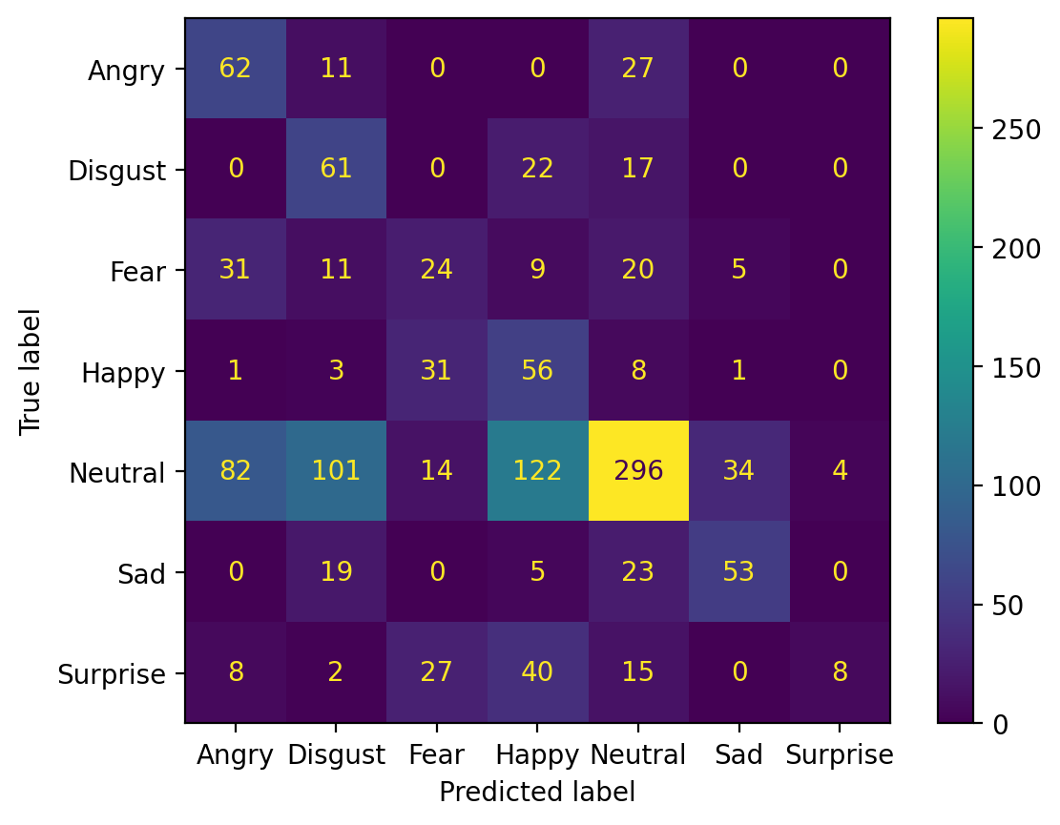
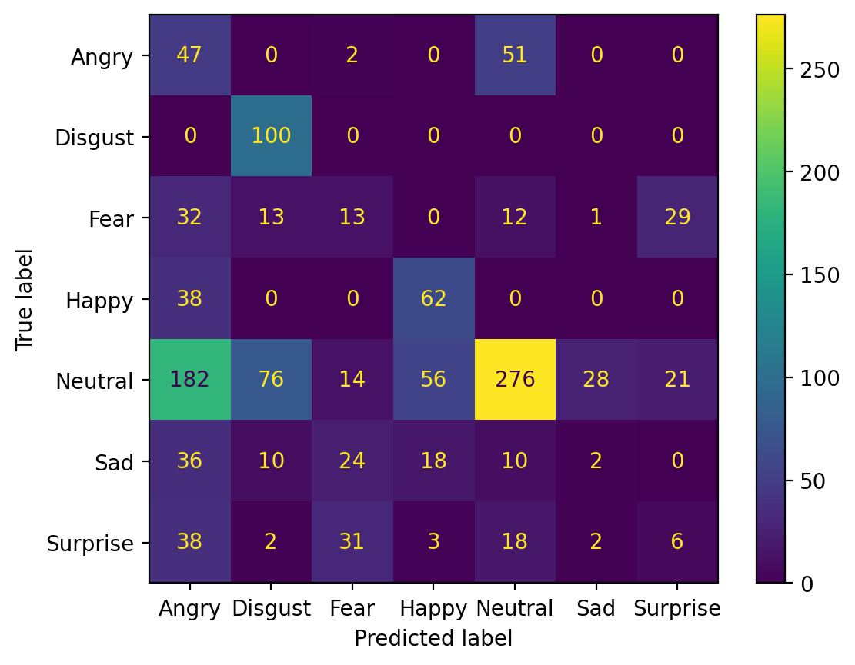
Eyeglasses Influence Performances
Participant without eyeglasses
40% accuracy
Participant with eyeglasses
45% accuracy
Notes:
One interesting fact we observed during our evaluation, was the eyeglasses impact on our models' performances.
We indeed observed that our models were performing poorer on the participant with eyeglasses with a difference of 5%, as shown by the two-confusion matrix here.
We observed that the misclassifications are especially on emotion involving specific upper facial expression such as anger (frowning), fear and surprise (eyes opening).
This impact could be explained by the fact that the HMD has trouble detecting the correct activated eyes blendshape when the user is wearing eyeglasses, thus leading to these misclassification.

Slide 16
Future Work
Increase training database size
More diverse participants
Also for evaluation
Action Units recognition
Build different emotion recognition system based on AUs
Use AUs-Emotions mapping system
Online evaluation
Build a VR application enabling live emotion recognition
Lab Streaming Layer or OSC
Notes:
It is important to note that there are still some works that could be achieved to improve our models’ performance and the evaluation method.
First, increasing the size of the database would be more than beneficial to improve the robustness and accuracy of our models and also increasing the number of participant for the evaluation would give us a more accurate vision of the models’ real performances.
Second, since we did not use our AUs labelled data, it might make sense to try to implement a new system for AUs recognition instead of directly recognizing emotions. This model could then predict emotion using predefined mapping between AUs and emotions.
Finally, to improve the evaluation of our models, it would be useful to build a VR application to have a real-time emotion recognition. One way to allow communication between a Unity app and our python models is to use Open Sound Control or Lab streaming layer.

Slide 17
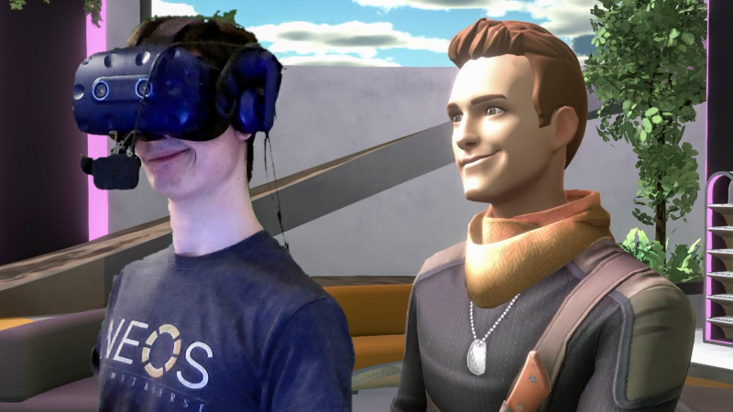
Conclusion
Limitations
Number of participants
Accuracy of models
Blendshapes usage for emotion recognition
Frooxius. (2021, March 13). Setting up avatars for VIVE Facial Tracker in Neos VR & Custom Scripting (tutorial) [Video]. Youtube. https://www.youtube.com/watch?v=OHyl90_X9SQ
Notes:
To conclude, the main limitations we were facing during this project was firstly our restricted number of participants, we did our best, but it may not have been enough to train correctly our models.
Thus, also explaining the relatively poor accuracy we got.
However, we still gave significant insights about the feasibility of using "blendshapes" to predict emotion and we provided ways to handle them to enable emotion recognition in real-time.

Slide 18

Many thanks!
Notes:
Thank you for your attention.
If you have questions, I’ll be happy to answer.

